Slide 1


Project 3 – Data Preparation using PYTHON and MySQL
Natanael Pitoun - Ferdinand Leube – Felicia Onwudinjo

Slide 2
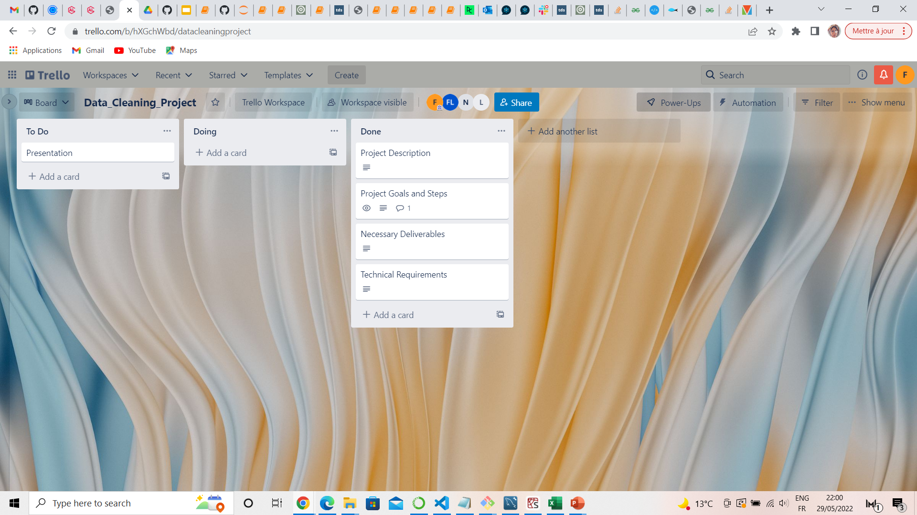
Project 3 – Data Preparation
Planning - Trello

Slide 3
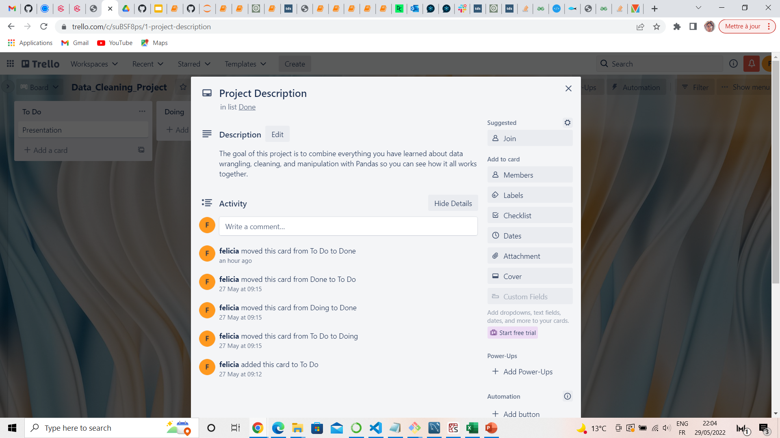

Slide 4
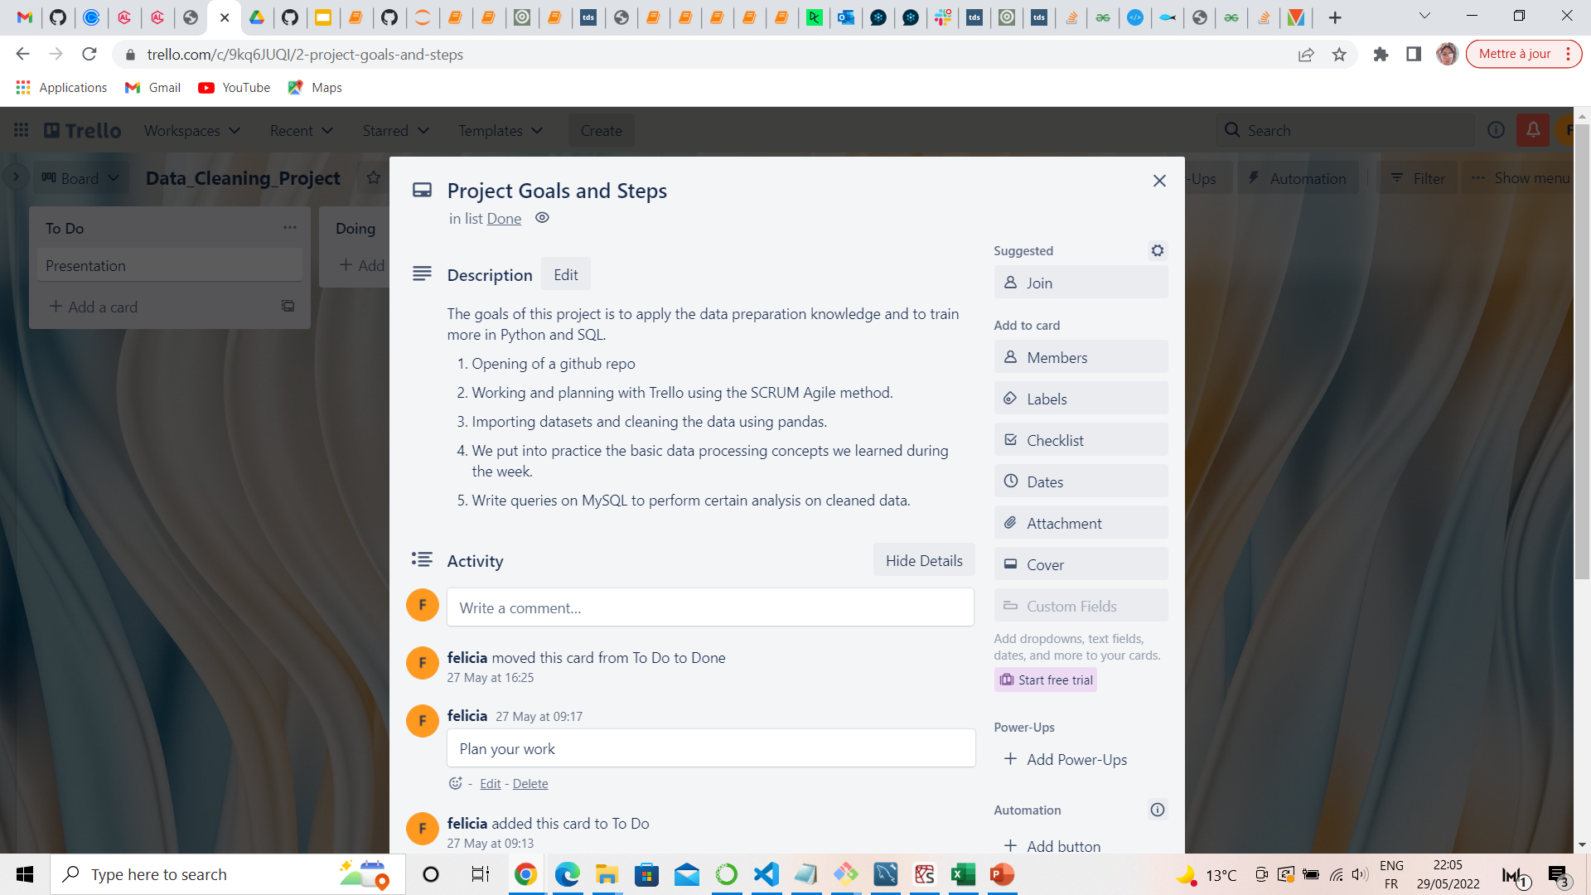

Slide 5
Project 2 - Creating Database in MYSQL
Description of the Data Preparation
We chose the dataset ‘new markets’ and downloaded a csv file.
The dataset was imported and read to python through the pandas library.
Our main goal was to clean the dataset to be used to draw insightful conclusions which included the following:
Examine the data for potential issues (missing data, data inconsistency, outliers, duplicates etc)
Dropping columns which of no use to our business goal.
Applying label encoding in pandas to relate columns and fill the null values
Getting the random values difference between the mean and standard deviation to fill in null values.

Slide 6
Project 2 - Creating Database in MYSQL
Sql Alchemy library
SQLAlchemy is a library that facilitates the communication between Python programs and databases . Most of the times, this library is used as an Object Relational Mapper (ORM) tool that translates Python classes to tables on relational databases and automatically converts function calls to SQL statements.
We used this library to link to our SQL database to create queries from our cleaned dataset.
We formulated 3 queries including using the Groupby statement, With statement to get insights on our dataset.

Slide 7
Project 2 - Creating Database in MYSQL
SQL – Script - Queries
We formulated queries such as:
To get the gender disparity between occupations and know which jobs had more men compared to women.
To know the spending score of a profession based on their family size.
We also checked to see the average number of graduates in each profession.

Slide 8
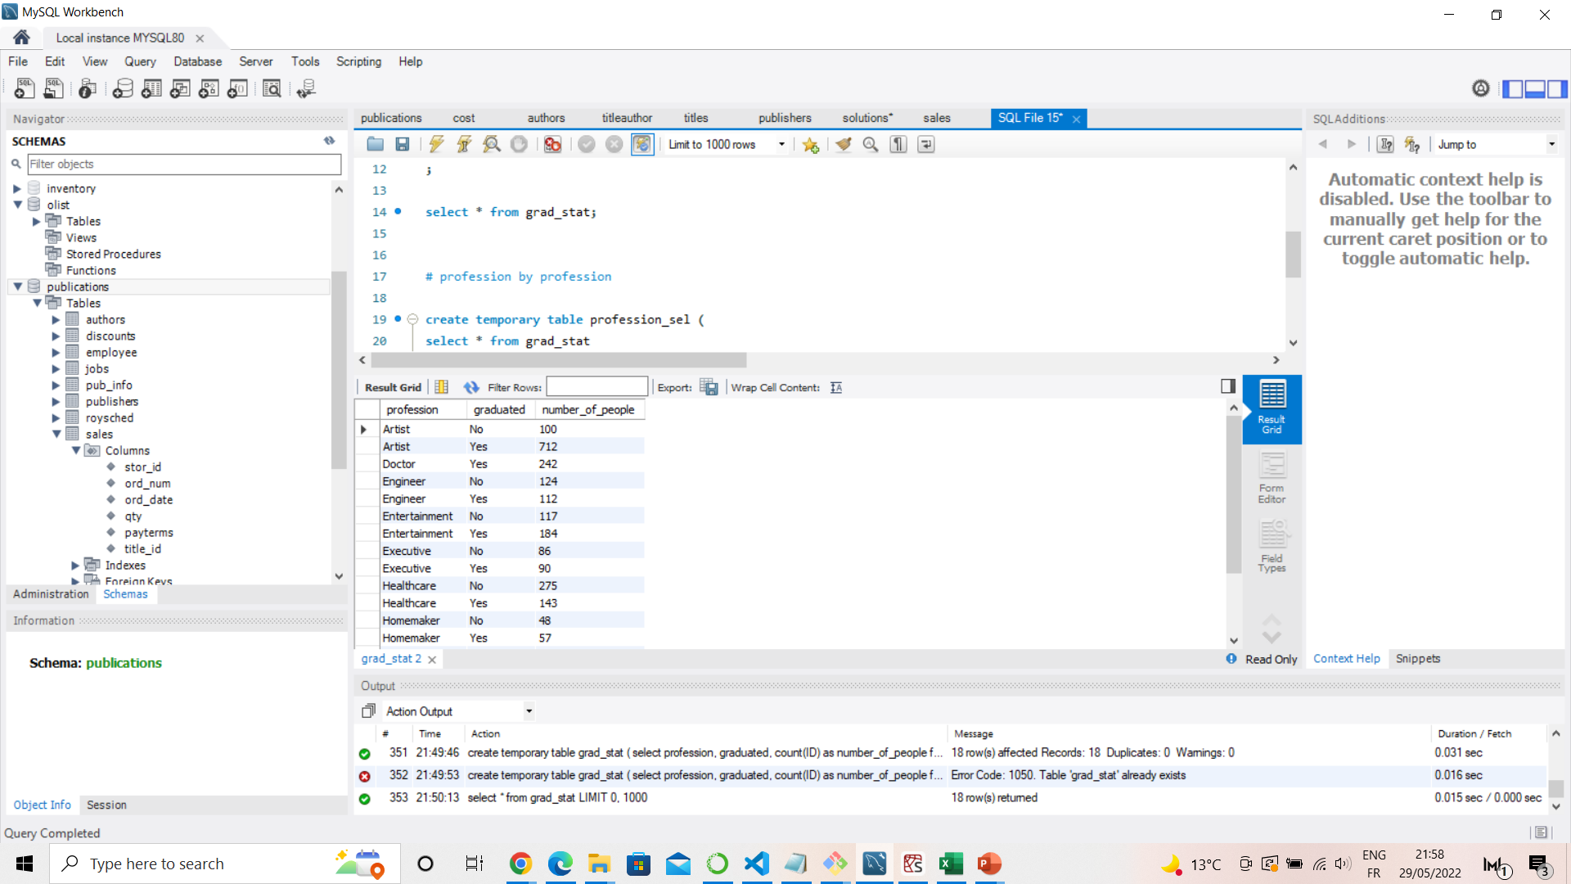
Project 2 - Creating Database in MYSQL
Demo

Slide 9
Project 2 - Composite Indicator
Questions
Q & A
TIME

Slide 10
Project 2 - Composite Indicator
The End
Thanks

